Slide 1
FTEC 6334_FALL 2020
GROUP PRESENT
CREDIT CARD DEFAULT PREDICTION
GROUP MEMBERS
Joy Nguyen
Phyllis Hung
Victor Olubanwo
Notes:
Change the background
Right-click the slide that you want to add a background picture and then click Format Background > Picture or Texture Fill
Under Insert picture from, do one of the following: To insert a picture from a file, choose File, and then locate and choose the picture that you want to insert.

Slide 2

INTRODUCTION
Credit card payment has been one of the most globally acceptable mode of payment in the world today
Banks and Financial Institutions plays a major role in providing financial services
Credit card debt has been a major concern to organizations both here in the US and in the world at large
Americans began 2020 owing more than $1 trillion in credit card debt after a $76.7 billion net increase during 2019
To reduce the number of likelihood of default, organizations would like to be able to predict the likelihood of customer’s default
ZACOMIC STUDIOS
DESING IS OUR PASSION
WWW.YOURSITE.COM
Notes:
Drag and Drop the Imagen
Selec the Image and From the Format tab, click the Bring Forward or Send Backward drop-down box.

Slide 3
BUSINESS CASE
A bad loan for company ABC can lead to a huge financial loss in the event of customer default
Company ABC would like to mitigate against customer’s default
The company currently utilize a manual process of identifying who might be a potential defaulter
Loan processing approval is solely based on credit score and income which might not reflect a true picture of customer’s financial condition
Company ABC also wants to be able to approve credit card applications from customers who will be able to pay back their loan
WWW.YOURSITE.COM
Notes:
Drag and Drop the Imagen
Selec the Image and From the Format tab, click the Bring Forward or Send Backward drop-down box.

Slide 4
OBJECTIVE
Our model will use all possible factors to predict data on customers to find out who will default next month and who will not
Identify which of the customers will be able to make their monthly credit card payment
Determine which customers might be late in making payment
Bring more consistency to the loaning process
Investigate the key drivers behind a potential defaulter
Notes:
Drag and Drop the Imagen
Selec the Image and From the Format tab, click the Bring Forward or Send Backward drop-down box.

Slide 5
DATA summary
The dataset considered in this analysis can be found on the Kaggle website
This dataset contains 30000 observations of 24 variables from a bank and credit card issue.
Each observation corresponds to a particular credit card client
Out of 30000 observations, it is estimated that 6,636(22.1%) observations are customers with default payment
Notes:
Drag and Drop the Imagen
Selec the Image and From the Format tab, click the Bring Forward or Send Backward drop-down box.

Slide 6
Data summary
 |  |  |  |  |  |  | Repayment Status |  |  |  |  |  | Amount of Bill Statement |  |  |  |  |  | Amount Paid
ID | default.payment.next.month | LIMIT_BAL | SEX | EDUCATION | MARRIAGE | AGE | PAY_1 | PAY_2 | PAY_3 | PAY_4 | PAY_5 | PAY_6 | BILL_AMT1 | BILL_AMT2 | BILL_AMT3 | BILL_AMT4 | BILL_AMT5 | BILL_AMT6 | PAY_AMT1 | PAY_AMT2 | PAY_AMT3 | PAY_AMT4 | PAY_AMT5 | PAY_AMT6
1 | 1 | 20000 | Female | University | Married | 24 | 2 | 2 | -1 | -1 | -2 | -2 | 3913 | 3102 | 689 | 0 | 0 | 0 | 0 | 689 | 0 | 0 | 0 | 0
2 | 1 | 120000 | Female | University | Single | 26 | -1 | 2 | 0 | 0 | 0 | 2 | 2682 | 1725 | 2682 | 3272 | 3455 | 3261 | 0 | 1000 | 1000 | 1000 | 0 | 2000
3 | 0 | 90000 | Female | University | Single | 34 | 0 | 0 | 0 | 0 | 0 | 0 | 29239 | 14027 | 13559 | 14331 | 14948 | 15549 | 1518 | 1500 | 1000 | 1000 | 1000 | 5000
4 | 0 | 50000 | Female | University | Married | 37 | 0 | 0 | 0 | 0 | 0 | 0 | 46990 | 48233 | 49291 | 28314 | 28959 | 29547 | 2000 | 2019 | 1200 | 1100 | 1069 | 1000
5 | 0 | 50000 | Male | University | Married | 57 | -1 | 0 | -1 | 0 | 0 | 0 | 8617 | 5670 | 35835 | 20940 | 19146 | 19131 | 2000 | 36681 | 10000 | 9000 | 689 | 679
6 | 0 | 50000 | Male | Graduate | Single | 37 | 0 | 0 | 0 | 0 | 0 | 0 | 64400 | 57069 | 57608 | 19394 | 19619 | 20024 | 2500 | 1815 | 657 | 1000 | 1000 | 800
7 | 0 | 500000 | Male | Graduate | Single | 29 | 0 | 0 | 0 | 0 | 0 | 0 | 367965 | 412023 | 445007 | 542653 | 483003 | 473944 | 55000 | 40000 | 38000 | 20239 | 13750 | 13770
8 | 0 | 100000 | Female | University | Single | 23 | 0 | -1 | -1 | 0 | 0 | -1 | 11876 | 380 | 601 | 221 | -159 | 567 | 380 | 601 | 0 | 581 | 1687 | 1542
9 | 0 | 140000 | Female | High School | Married | 28 | 0 | 0 | 2 | 0 | 0 | 0 | 11285 | 14096 | 12108 | 12211 | 11793 | 3719 | 3329 | 0 | 432 | 1000 | 1000 | 1000
10 | 0 | 20000 | Male | High School | Single | 35 | -2 | -2 | -2 | -2 | -1 | -1 | 0 | 0 | 0 | 0 | 13007 | 13912 | 0 | 0 | 0 | 13007 | 1122 | 0

Slide 7
Data summary
Independent Variables: crucial factors to consider when predicting a customer’s probability of default
Credit Limit – Amount given in credit
Demographic Information
Sex – Gender
Age – range from 21 to 79
Marriage Status
Level of Education
Historical Payments Information
Six-month repayment history - Consider how many months payments was delayed
Amount of bill settlement – How much the customer was billed within the last six months
Amount of previous payments – Actual amount the customer paid within the last six months
Dependent Variable
Default – if a customer will default next month (0: No, 1: Yes)
WWW.YOURSITE.COM
Notes:
Drag and Drop the Imagen
Selec the Image and From the Format tab, click the Bring Forward or Send Backward drop-down box.

Slide 8
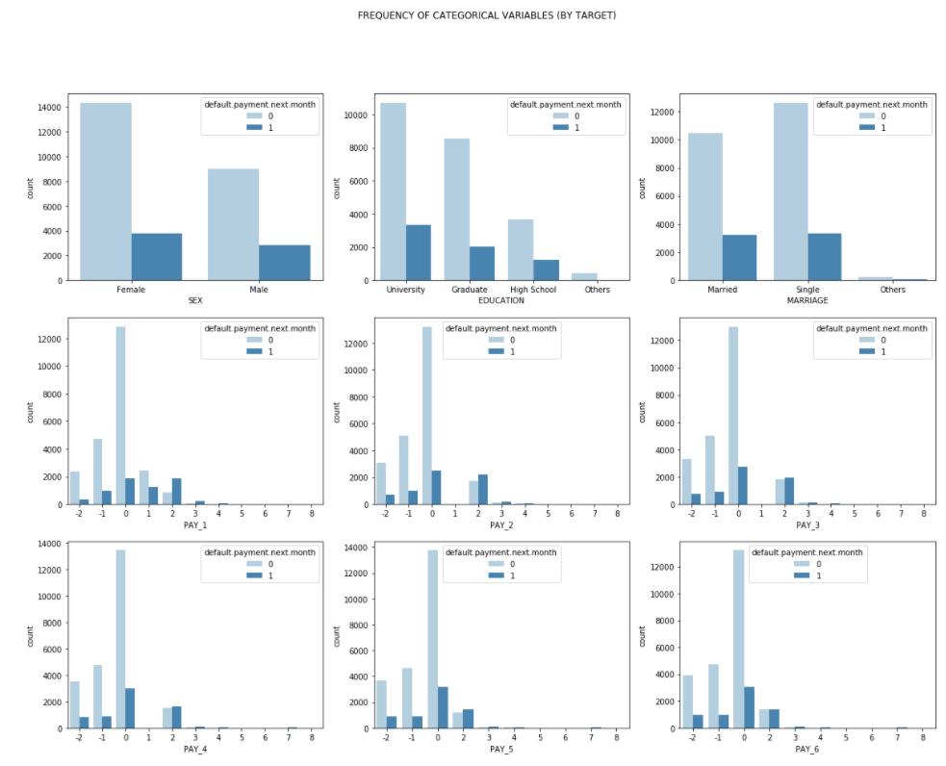
Data Statistics & visualization
Categorical Variables
WWW.YOURSITE.COM
Notes:
→ Imbalance in Data

Slide 9
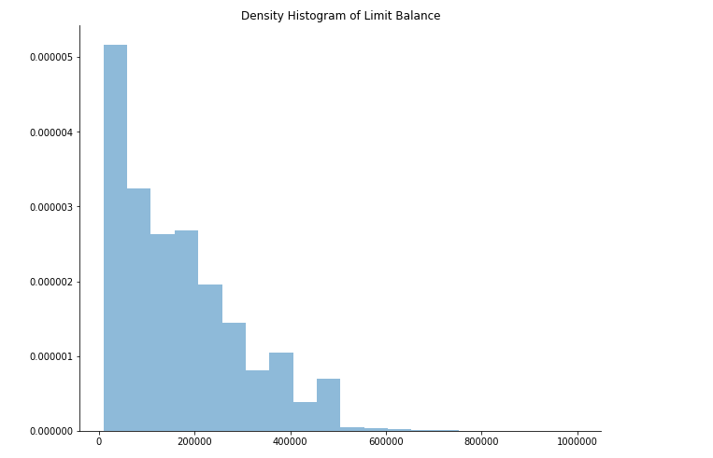
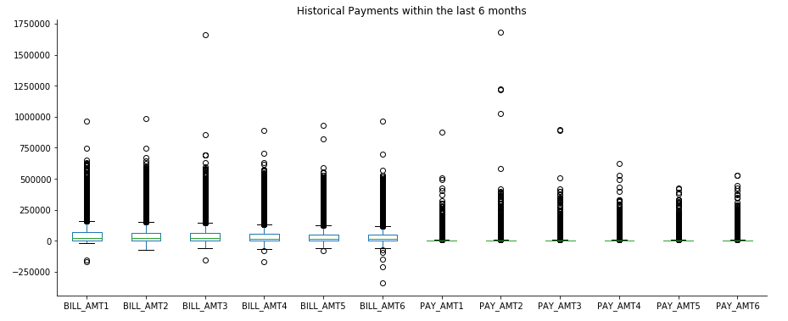
Data Statistics & visualization
Numerical Variables
Notes:
→ High skewness and outliers in data

Slide 10
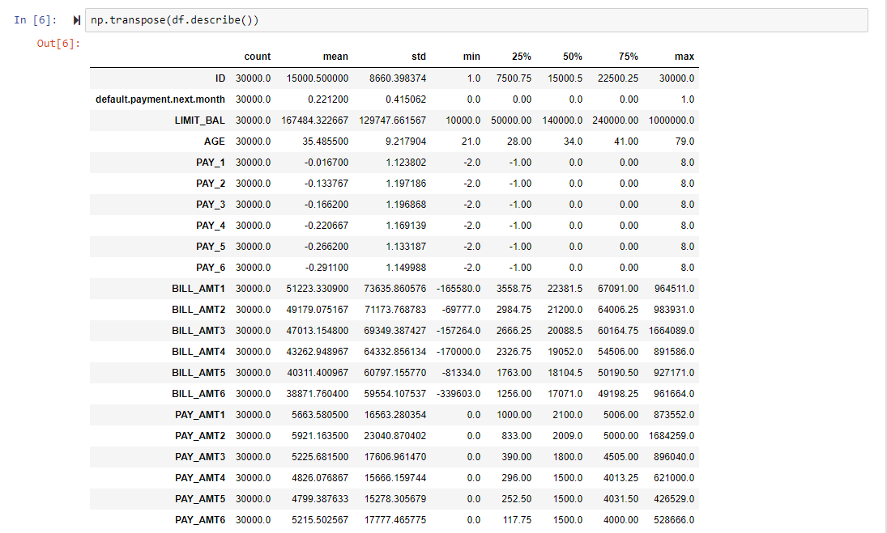
Data statistics

Slide 11



Data preprocessing
imputation
Encoding
scaling
sampling

Slide 12
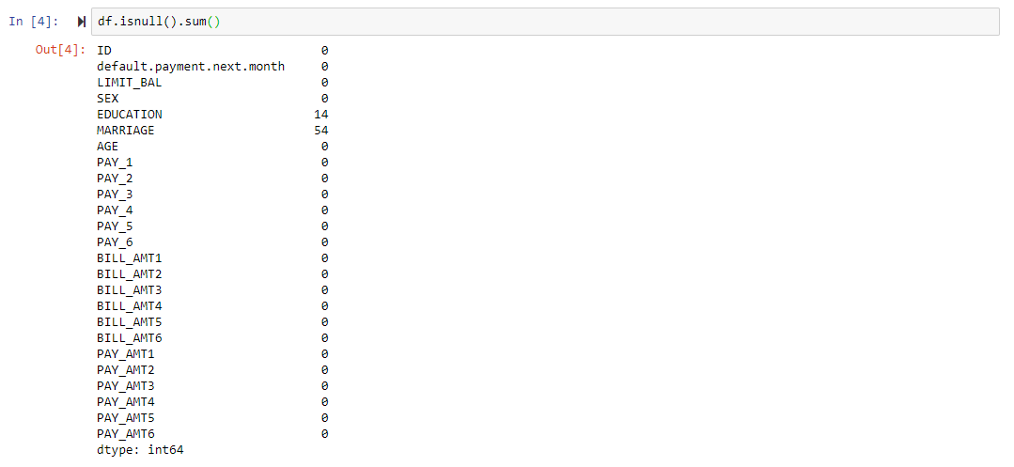
1. IMPUTATION
Missing Values Check:
There are a few predictive models that can internally handle incomplete data such as XGBoost. However, many popular predictive models such as neural networks, cannot tolerate any amount of missing values
There are missing values in “EDUCATION” and “MARRIAGE”.
Common Methods to handle Missing Data:
Deletion of Data: may result in model’s bias → don’t want to throw away samples
Encoding: the number of missing values is small and should not have high effect to the model → Creating new category for missing values may affect model’s interpretation
Imputation: SimpleImputer - replace missing values with the most frequent values → most appropriate for our data
s

Slide 13
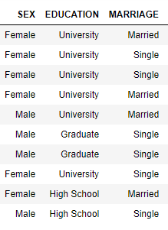
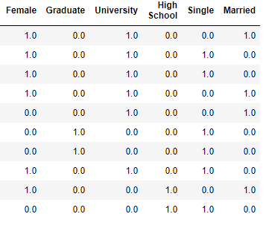
2. Encoding
Predictive models that depend on numeric inputs cannot directly handle open text fields
Those information need to be processed prior to be included in the model
There are 3 variables to be encoded in our data: “SEX”, “EDUCATION”, and “MARRIAGE”
Common Method: Creating Dummy Variables or One-hot Coding
s

Slide 14
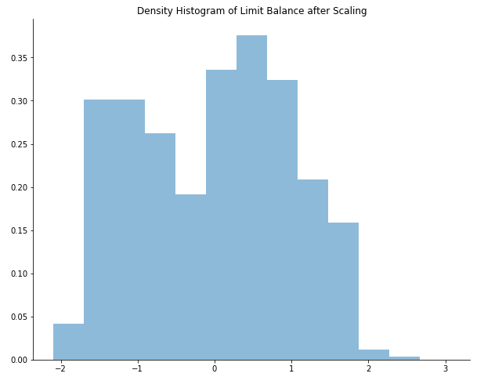
3. Scaling
The distribution is where we should focus our attention.
A simple log-transformation, or more complex Box-Cox or Yeo-Johnson transformation, can be used to place the data on a scale where the distribution is approximately symmetric, thus removing the appearance of outliers in the data
s
Notes:
The Box-Cox procedure, originally intended as a transformation of a model’s outcome, uses maximum likelihood estimation to estimate a transformation parameter λ in the equation:
x∗={xλ−1/λ~xλ−1,λ≠0
~xlogx,λ=0

Slide 15

4. Sampling
Split the data into two groups:
Training Set: used to develop models and feature sets
Test Set: used to estimate the final model’s performance
Rule of Thumb: 80/20
Completely random sampling is not appropriate as the response is not evenly distributed across the outcome
Stratified approach: selecting samples at random within each class
→ Ensures the frequency distribution of the outcome is approximately equal within the training and test sets
Notes:
random_state: int or RandomState instance, default=NoneControls the shuffling applied to the data before applying the split. Pass an int for reproducible output across multiple function calls

Slide 16
Techniques to exploit
simple
Clustering
Naïve Bayes
ensemble
DEEP learning

⬄
⬄
⬄
⬄
Logistic Regression Model
K-Nearest Neighbors
Gaussian Naïve Bayes
Random Forest
Neural Network Model
Ensemble XGBoost Model

Slide 17
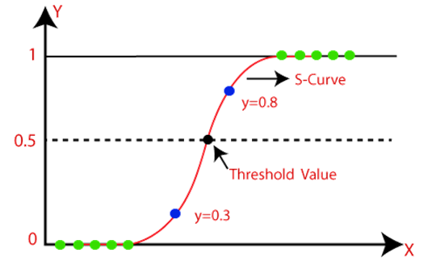
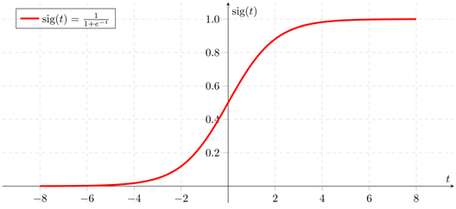
1. Logistic regression
Binary output and discrete categories
Logit function = LN(Odd) = sigmoid function (continuous input with probabilities)
Notes:
binary output and discrete categories
Logit function = LN(Odd) = sigmoid function (continuous input with probabilities)

Slide 18
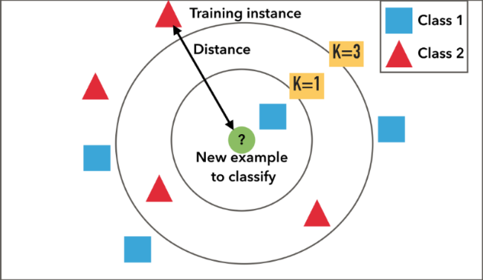
2. K-Nearest Neighbors (knn)
K-nearest neighbor model stores the training set data and locates the K training set points that are in the closest proximity to the new sample → a prediction is made by setting outcomes for the neighbors
Example:
Where should the green point belong to?
Blue points: Class 1
Red points: Class 2
→ Red!
Notes:
- Scalable, Portable and Distributed Gradient Boosting
- optimize loss function
- Large scale boosted tree
- 10 times faster than other common tools
EX: Sum up the prediction score of each leaf

Slide 19
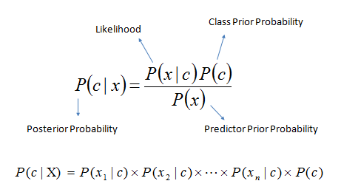
3. Naïve - bayse
Bayes Theorem with probabilistic classifier
Less estimated parameters
More suitable for independent variables
Not sensitive with missing values
Simple calculation
Notes:
- Scalable, Portable and Distributed Gradient Boosting
- optimize loss function
- Large scale boosted tree
- 10 times faster than other common tools
EX: Sum up the prediction score of each leaf

Slide 20
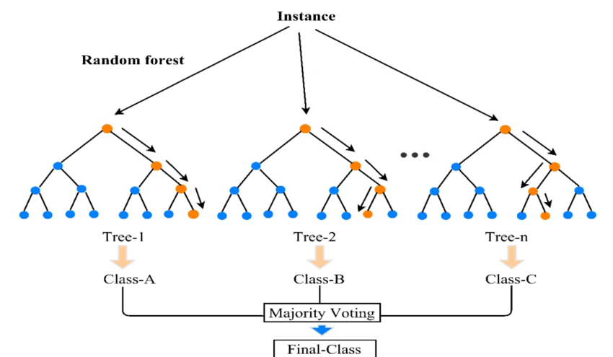
4. Random forest
Outperform decision trees
Accuracy is lower that gradient boosting
Output is the mode of classes or mean prediction of the individual trees
Notes:
- Scalable, Portable and Distributed Gradient Boosting
- optimize loss function
- Large scale boosted tree
- 10 times faster than other common tools
EX: Sum up the prediction score of each leaf

Slide 21
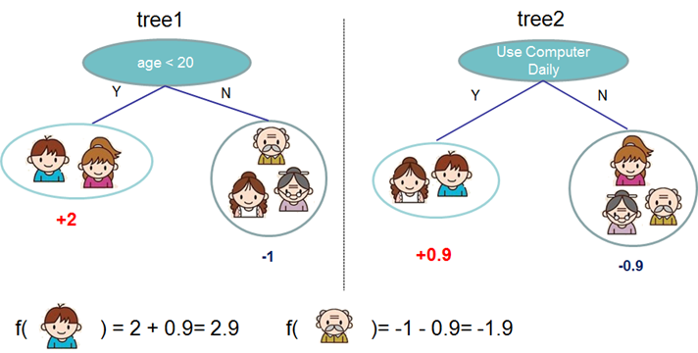
5. XGBOOSt – extreme gradient boosting
Scalable, Portable and Distributed Gradient Boosting
Optimize loss function
Large scale boosted tree
10 times faster than other common tools
Example: Sum up the prediction score of each leaf
Notes:
- Scalable, Portable and Distributed Gradient Boosting
- optimize loss function
- Large scale boosted tree
- 10 times faster than other common tools
EX: Sum up the prediction score of each leaf

Slide 22
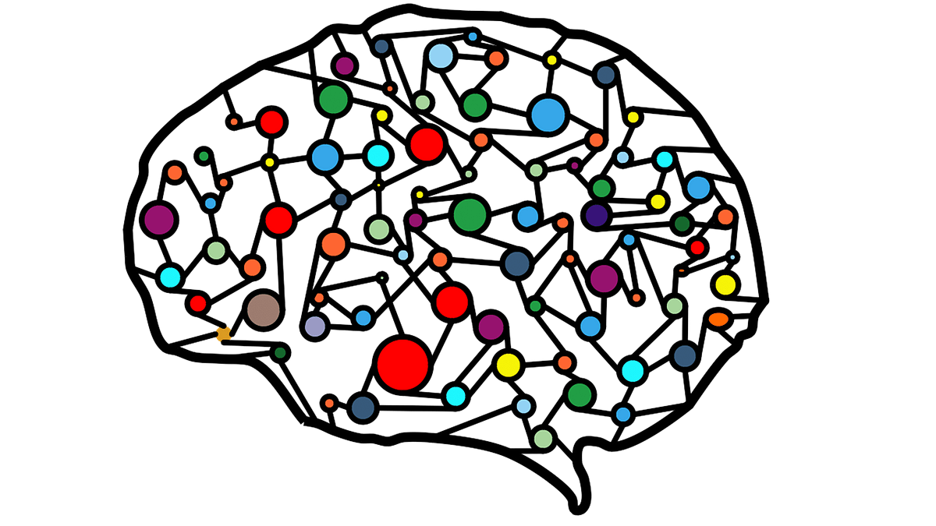

2.Neural network
Notes:
- Scalable, Portable and Distributed Gradient Boosting
- optimize loss function
- Large scale boosted tree
- 10 times faster than other common tools
EX: Sum up the prediction score of each leaf

Slide 23
hyperparameters
Tuning parameters
Control the complexity of the model and thus also affect any variance-base trade-off that can be made
Procedure: grid search
A set of candidate tuning parameter values are specified and then evaluated by score through resampling

Slide 24
Grid search: number of neighbor in knn model
The number of neighbors (K) controls the complexity and the variance and bias of the models.
Too small: potential for overfitting since only few values are used for prediction and are most susceptible to changes in the data
Too large: too many potentially irrelevant data points are used for prediction resulting in an underfit model
Rule of Thumb: K = SQRT(n) ~ 173
Grid search range: [1, 50, 87, 173, 259]
Results:
Ks | Accuracy | AUC
1 | 0.549222 | 0.698333
50 | 0.653550 | 0.780167
87 | 0.653761 | 0.777167
173 | 0.648795 | 0.777167
259 | 0.647463 | 0.779167
→ Best Number of Neighrbor = 87
Notes:
binary output and discrete categories
Logit function = LN(Odd) = sigmoid function (continuous input with probabilities)

Slide 25
Grid search: ensemble models
Number of Trees: controls prediction performance of model
Learning Rate controls the time consuming when running model
Maximum of Depth controls the trade of between deeper model and number of trees
Grid Search Range:
n_trees = [20, 100, 200, 500]
learning_rates = [0.1, 0.3, 0.5, 0.8]
max_depths = [2, 4, 6, 8]
Notes:
the benefit in prediction performance from learning more trees will be lower than the cost in computation time for learning these additional trees

Slide 26
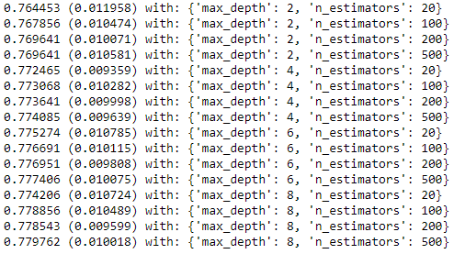
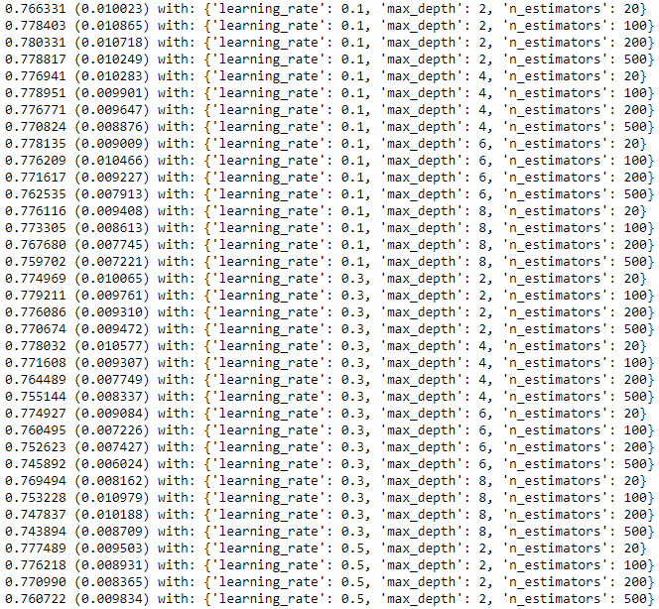
Grid search: ensemble models Results by ROC_AUC score
RANDOM FOREST
XGBOOST
Notes:
the benefit in prediction performance from learning more trees will be lower than the cost in computation time for learning these additional trees

Slide 27
Grid search: neural network
Size: [Number of Hidden Layers, Number of Nodes inside each Layer]
→ Rule of Thumb: Nodes = 2N – 1 for second layers & N for the last hidden layer
Drop-out Rate controls nodes connection in each layer to avoid overfitting
Batch Size number of subsets for stochastic gradient descent
→ Popular batch size include 32, 64, 128 (2^n, number of ways the bits in a binary word of length n can be arranged)
Epochs number of times that the learning algorithm will work through the entire training dataset
→ One epoch leads to underfitting of the curve in the graph, but too many epochs may result in overfitting
Grid Search Range:
size = [[26], [51,26], [51,51,26]]
rates = [[0.1], [0.2], [0.5]]
batch_size = [32, 64, 128]
epochs = [10, 20]
Notes:
the benefit in prediction performance from learning more trees will be lower than the cost in computation time for learning these additional trees

Slide 28
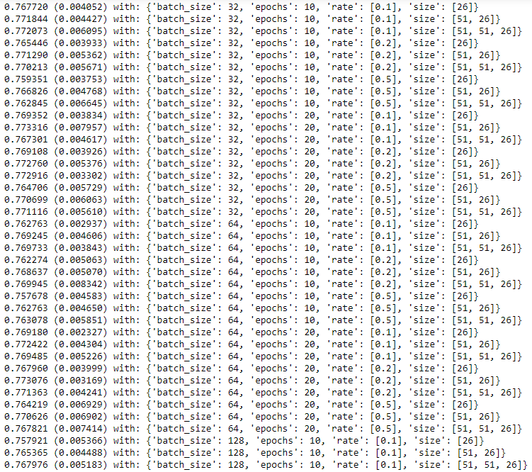
Grid search: Neural Network Results by ROC_AUC score
Best Parameters with AUC score = 77.33%
2 hidden layers with number of nodes: [51, 26]
Drop out rate = 0.1 (90% connection in each node)
Bacth size = 32
Epochs = 20
Notes:
the benefit in prediction performance from learning more trees will be lower than the cost in computation time for learning these additional trees

Slide 29
fitting models
SUBTITLE EXAMPLE

Slide 30
Feature selection
Predictive performance is degraded as the number of uninformative predictors increases. Moreover, many of the original predictors also may not contain predictive information
Need to appropriately select predictors for modeling
Approach: Recursive Feature Elimination (RFE)
A backward selection of the predictors
Begins by building a model on the entire set of predictors and computing an importance score for each predictor
Removes least important predictor(s)
Re-builds the model, and importance scores are computed again
Notes:
the benefit in prediction performance from learning more trees will be lower than the cost in computation time for learning these additional trees

Slide 31
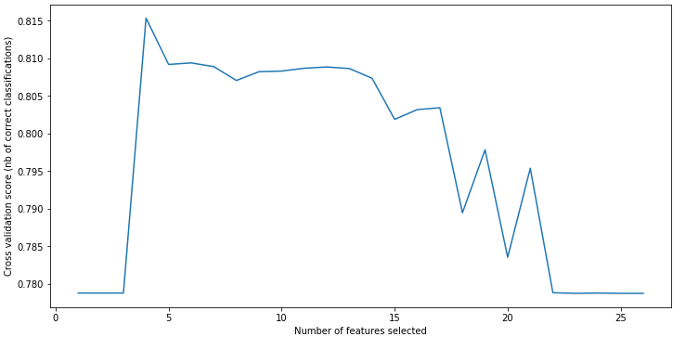
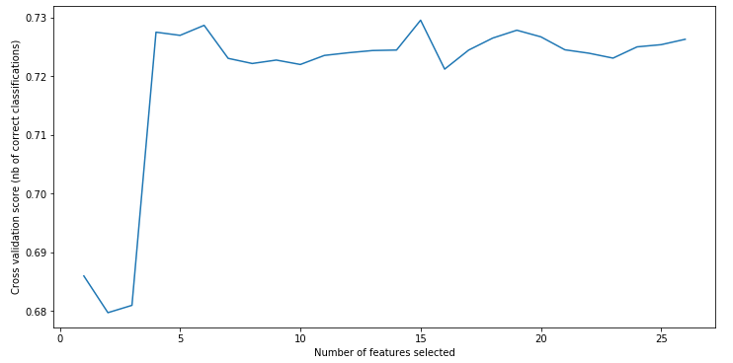
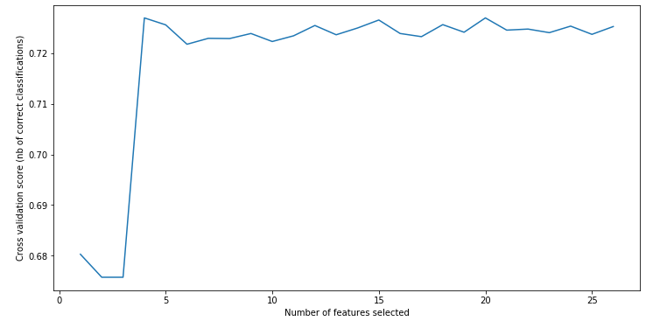
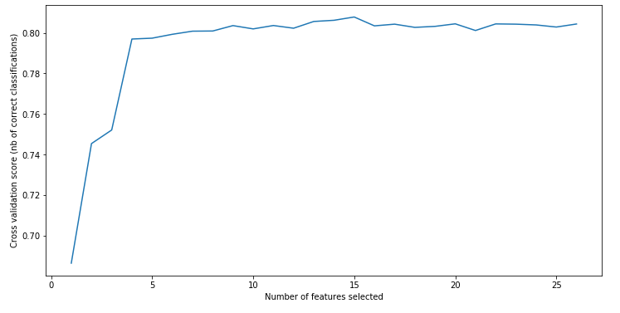
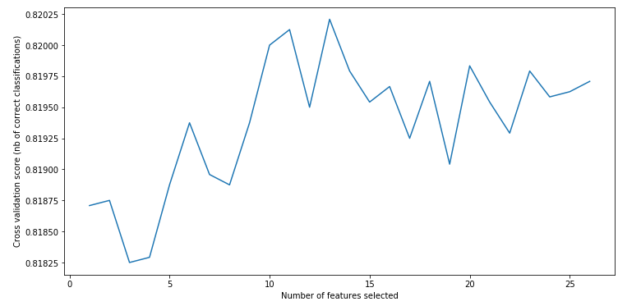
Feature selection
Graphs of cross validation AUC score according to number of features selected
Logistic Regression Model = 4
K-Nearest Neighbors = 15
Gaussian Naïve Bayes = 4
Random Forest = 23
Ensemble XGBoost Model = 13
Notes:
the benefit in prediction performance from learning more trees will be lower than the cost in computation time for learning these additional trees

Slide 32
model selection
Feature Selection improves the performance of most of models
Performance Scores:
High accuracy:
Affected by the threshold
Accuracy = (TP+TN) / all samples → TP high or TN high
High AUC:
AUC is more stable to deal with skewed distribution, so we should choose the model which has the highest AUC
Models | Without Feature Selection |  | With Feature Selection
Learning Rates | Accuracy | AUC | Accuracy | AUC
Logistic | 77.89% | 64.49% | 82.27% | 70.10%
K-NN | 77.72% | 65.37% | 77.72% | 65.37%
Naïve Bayes | 40.5% | 66.11% | 77.87% | 67.60%
Random Forest | 82.27% | 77.77% | 82.27% | 77.32%
XGB | 80.6% | 77.83% | 82.18% | 77.66%
Neural Network | 82% | 65.83% | 82% | 65.83%
Notes:
the benefit in prediction performance from learning more trees will be lower than the cost in computation time for learning these additional trees

Slide 33
model selection
Interesting Findings
Accuracy low but AUC high: => Naïve Bayes
Depends on the chosen threshold
Classifier achieves good performance on the positive class (high AUC) at the cost of a high false negatives rate (or a low number of true negative)
Accuracy high but AUC low: => Logistic Models
Unbalanced distribution
Many classification errors → classification ability is low, but accuracy can still be high due to the small effects
Selection: XGBoost with the best AUC rather then Accuracy
Models | Without Feature Selection |  | With Feature Selection
Learning Rates | Accuracy | AUC | Accuracy | AUC
Logistic | 77.89% | 64.49% | 82.27% | 70.10%
K-NN | 77.72% | 65.37% | 77.72% | 65.37%
Naïve Bayes | 40.5% | 66.11% | 77.87% | 67.60%
Random Forest | 82.27% | 77.77% | 82.27% | 77.32%
XGB | 80.6% | 77.83% | 82.18% | 77.66%
Neural Network | 82% | 65.83% | 82% | 65.83%
Notes:
the benefit in prediction performance from learning more trees will be lower than the cost in computation time for learning these additional trees

Slide 34
Model interpretation & application

Slide 35
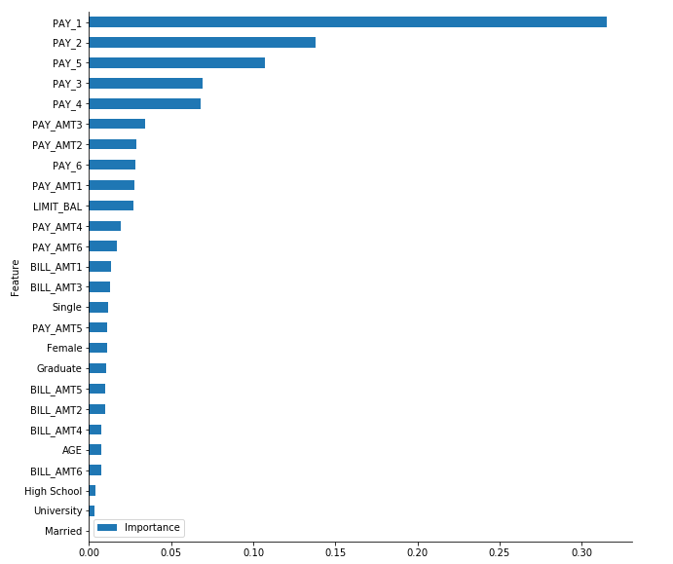
Features importance
Weighted Model to avoid imbalance data
Features Importance Score is calculated for weighted XGBoost Model
Most of variables have feature importance in the model
Historical Payment Information has the highest importance score
Notes:
the benefit in prediction performance from learning more trees will be lower than the cost in computation time for learning these additional trees

Slide 36
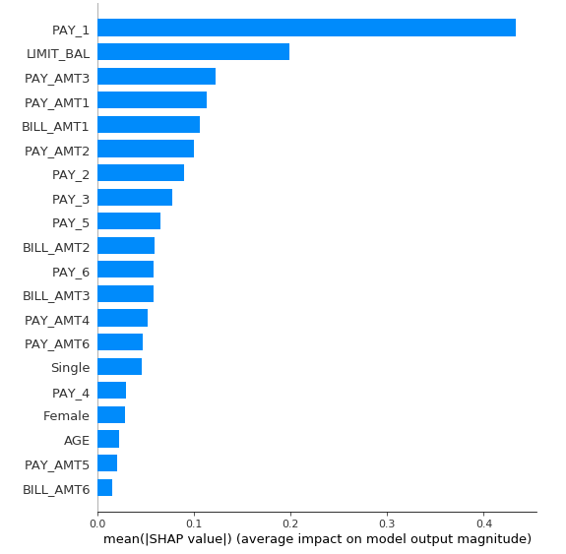
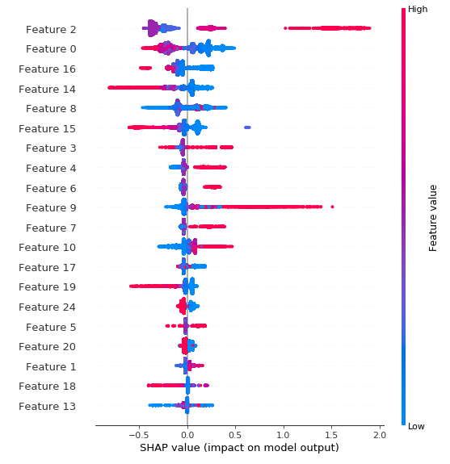
SHAP summary analysis
The higher the total amount paid in the last 6 months, the higher the positive impact on the relevance
The lower the limit balance, the higher the positive impact on the relevance

Slide 37
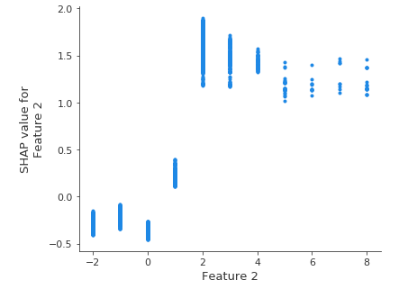
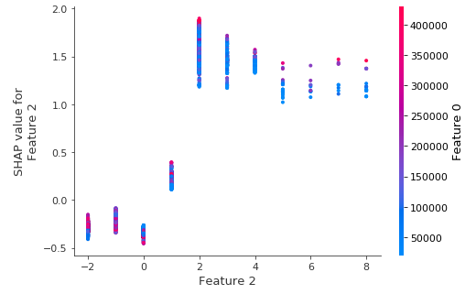
SHAP dependence analysis
Compares a chosen feature with another one and shows if these two features have an interaction effect
Feature 2 = Historical Repayment Status
Feature 0 = Limit Balance
Clients with Late Repayment Status and Low Limit Balance are less likely to default than those with Late Repayment Status and High Limit Balance

Slide 38

Model application
Consider not only a customer’s demographical information, but also the historical payments status to predict the probability of default in the next month
Can be developed to build dynamic models
Help the banks or companies to act or make decision at the right time to minimize the loss.
For example:
Offer a payment plan
Adjust credit-risk management

Slide 39
GROUP PRESENT
THANK YOU FOR LISTENING
ANY QUESTIONS?

